Slide 1
Capstone Project:
Netflix Data
Prepared by Asenbaev M
Date: 12.04.2020

Slide 2
Introduction

Slide 3
Netflix Stock Profile
I’ve been hired as a data visualization developer at Yahoo Finance! My job is to help financial analysts by creating some of the visualizations for a stock profile of Netflix.
In finance, a stock profile is a series of studies, visualizations, and analyses that dive into different aspects a publicly traded company’s data.
The analysis and visualizations are based on Netflix and Dow Jones data from 2017.
I’ve used the following Python libraries:
Pandas
Matlotlib
Seaborn
Code and visualizations prepared using Jupyter Notebook.

Slide 4
Content

Slide 5
The distribution of the stock prices for the past year
Netflix's earnings and revenue in the last four quarters
The actual vs. estimated earnings per share for the four quarters in 2017
A comparison of the Netflix Stock price vs the Dow Jones Industrial Average price in 2017

Slide 6
Format

Slide 7
Visualization
Findings
Visualizations of the data.
Presented in tandem with findings
Assertions and conclusions based on the visualizations.
Presented in tandem with visualization

Slide 8
Stock Profile

Slide 9
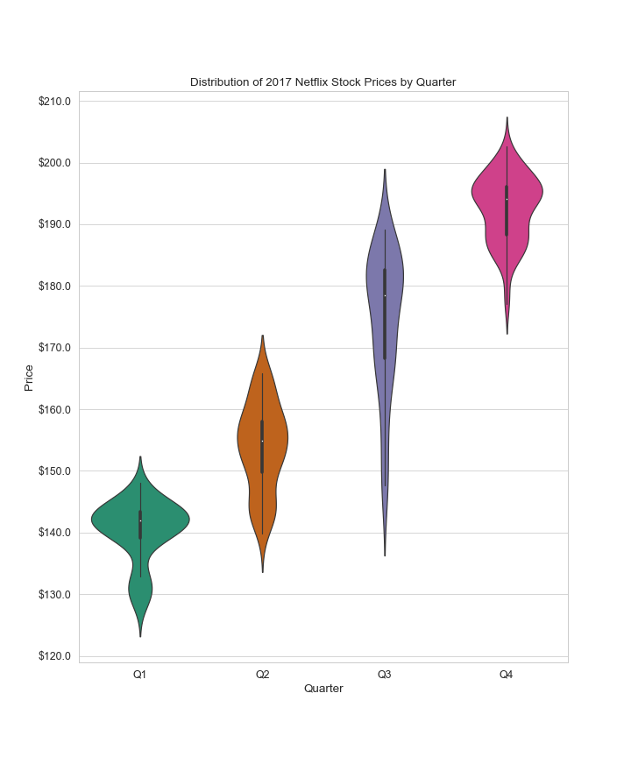
Stock Health
There was a moderate growth in shares over the entire period.
Mostly Closing stock prices fluctuated between $140 and $200.
The lowest point was $127 and the highest point $202.
As we can see from the graph,
Q3 had a wide distribution of closing stock prices from $146 to $189. There was a very high volatility in closing stock prices.

Slide 10
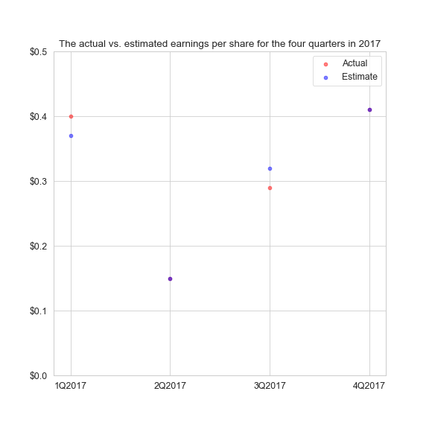
EPC
review
This scatter plot of Actual vs Estimated EPC shows that Yahoo’s prediction matched right in Q2 and Q4.
In other quarters Yahoo’s prediction was close to the actual EPC with an average 9% error, $0.4 vs $0.37 and $0.29 vs $0.31

Slide 11
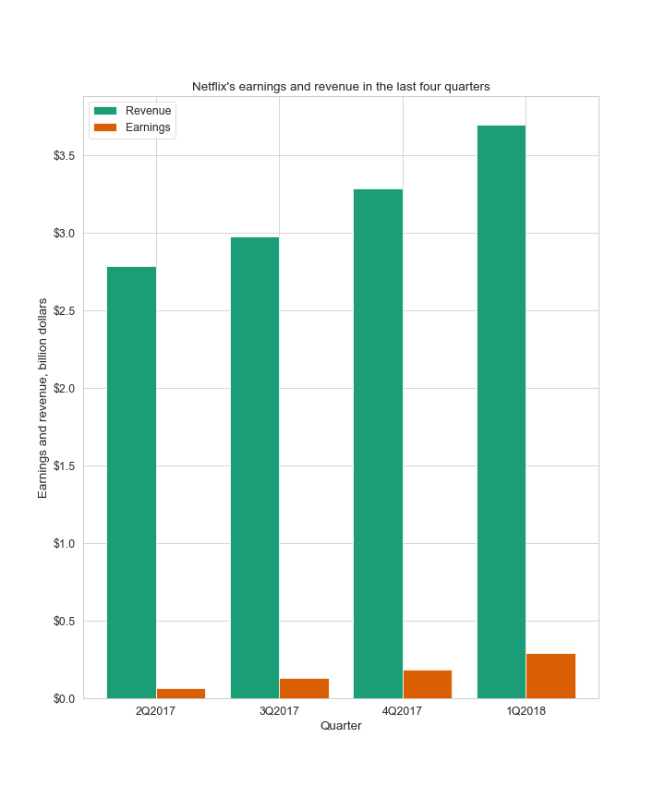
Earnings vs
Revenue
As is shown in bar chart Netflix’s earnings and revenue had an upward trend throughout the period.
Revenue was $ 2.79B and earnings was $ 65.6M in the first quarter.
And in the last quarter revenue was $3.7B and earnings was $290M.

Slide 12
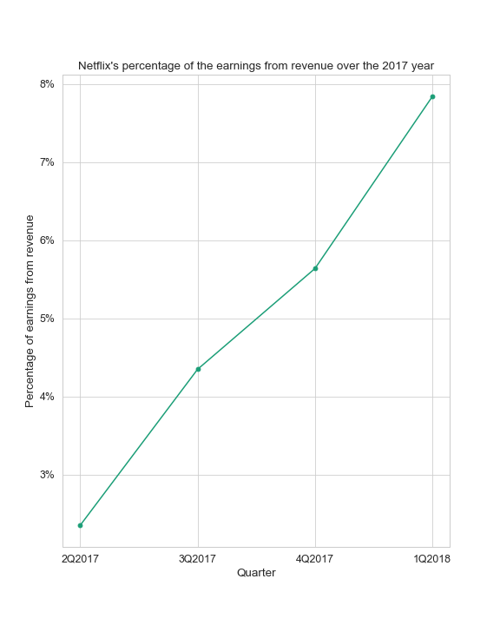
EPC
review
It is valuable to note that the share of profit from revenue showed a more than three and a half times increase from 2.3% to 7.8%.

Slide 13
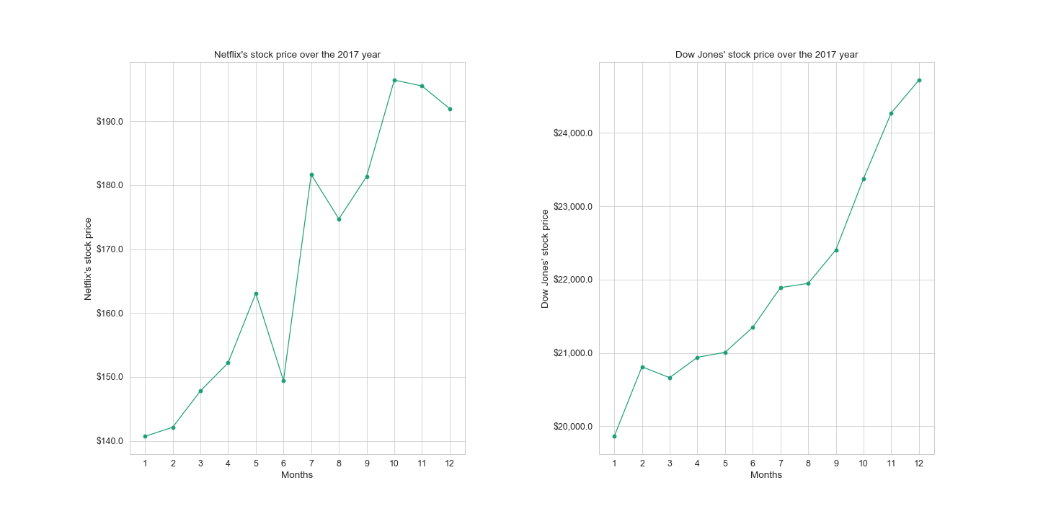

Slide 14
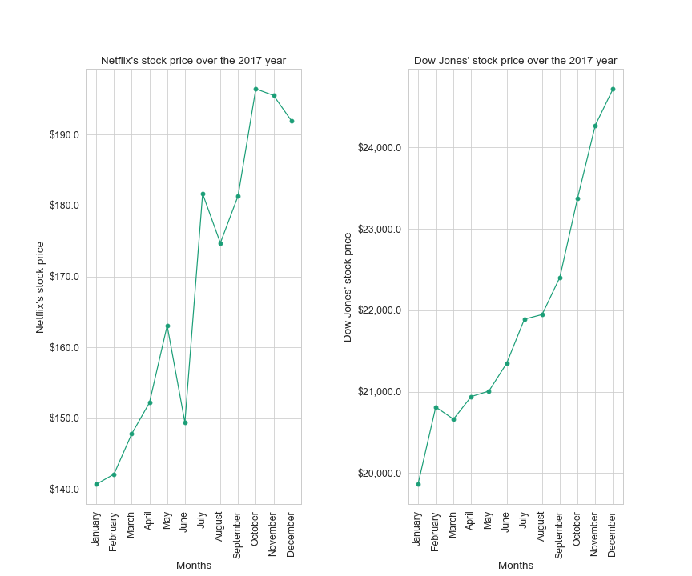
Stock
vs DJIA
Overall, both DJ index and Netflix stock prices demonstrated a rise by 124% and 136% throughout the period.
There was only one decline in DJIA in Q1, whereas Netflix’s stock prices had 3 downturns in Q2, Q3, Q4.
These facts suggest that the decline in Netflix shares’ price was a special case, not a Dow Jones trend.

Slide 15
The end

